Slide 1
ENGRAVING ALPHABETS ON METALS & SHEETS
ME 307d NC MACHINE TOOLS PROJECT
Under the guidance of :
Dr. P K JAIN
Prepared by : M Shiva Sai
2014230

Slide 2
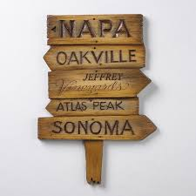

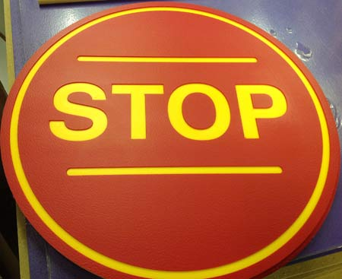

Slide 3
Traditional removal of metal by man power takes lot of time
Imprinting of a die like structure may result in change of shape of sheet due to application of large amount of forces.

Slide 4
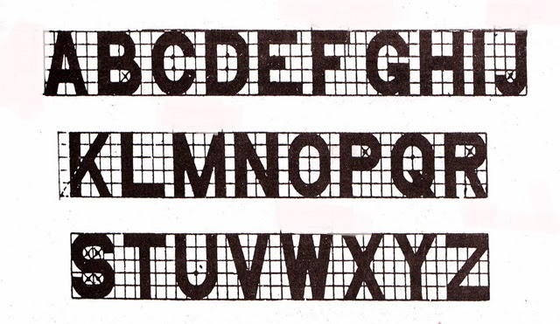
Principle Used

Slide 5
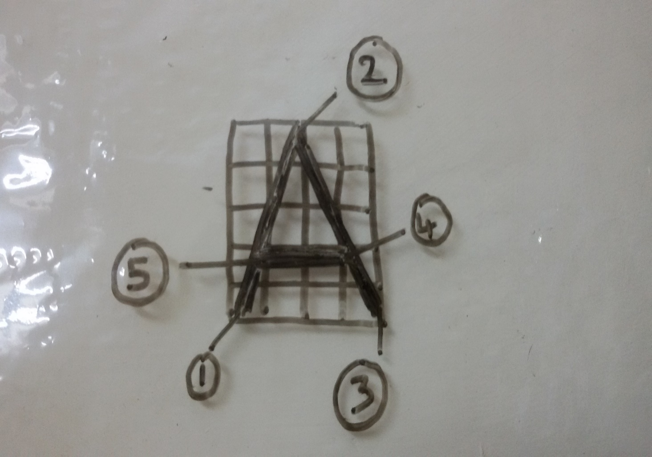
Height of the letter be a = 5x(let)
Width = 4x
1 (0,0)
(2x,5x)
(4x,0)
(3x,2.5x)
(x,2.5x)
Linear interpolation from 1->2->3->4->5 and then lift the tool and move to the next position.

Slide 6
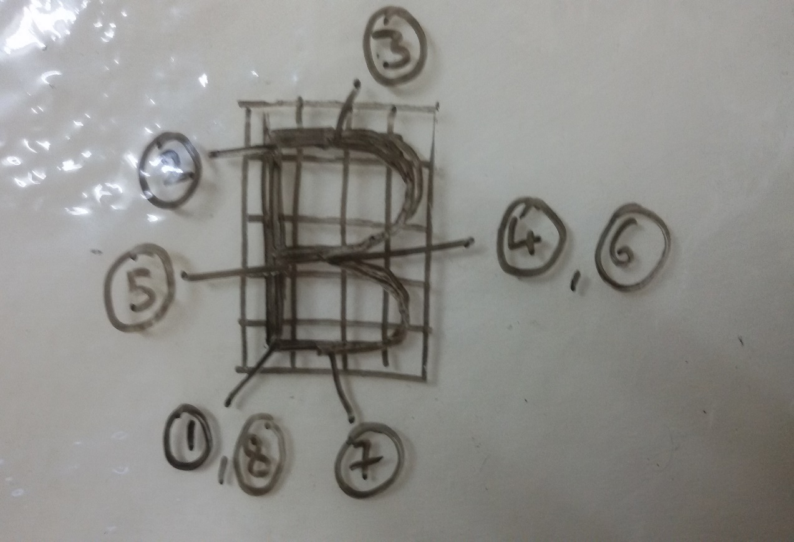
Height of the letter be a = 5x (let)
Width = 4x
(0,0)
(0,5x)
(2x,5x)
(2x,2.5x)
(0,2.5x)
(2x,2.5x)
(2x,0)
(0,0)
Linear interpolation from 1->2->3
CW Circular interpolation from 3->4
Linear interpolation 4->5->6
CW Circular interpolation from 6->7
Linear interpolation from 7->8 and then lift the tool and move to the next position.

Slide 7
Main Program
function Characters(chars,a,file)
m = length(chars);
str = java.lang.String(chars);
for x = 0:m-1
switch str.charAt(x)
case 'A'
getA(file,x,a);
case 'B'
getB(file,x,a);
.
.
.
.
.
.
.
end
end
end

Slide 8
function getA(file,n,a)
fileID = fopen(file,'a');
A = [n*a 0 0];
fprintf(fileID,'G00 X %4.2f Y %4.2f Z %4.2f\n',A);
A = [0+(n*a) 0 -1];
fprintf(fileID,'G01 X %4.2f Y %4.2f Z %4.2f\n',A);
A = [(4*a/10)+(n*a) a -1];
fprintf(fileID,'G01 X %4.2f Y %4.2f Z %4.2f\n',A);
A = [(4*a/5)+(n*a) 0 -1];
fprintf(fileID,'G01 X %4.2f Y %4.2f Z %4.2f\n',A);
A = [(3*a/5)+(n*a) (a/2) -1];
fprintf(fileID,'G01 X %4.2f Y %4.2f Z %4.2f\n',A);
A = [(a/5)+(n*a) (a/2) -1];
fprintf(fileID,'G01 X %4.2f Y %4.2f Z %4.2f\n',A);
A = [(a/5)+(n*a) (a/2) 0];
fprintf(fileID,'G01 X %4.2f Y %4.2f Z %4.2f\n',A);
A = [a+(n*a) 0 0];
fprintf(fileID,'G00 X %4.2f Y %4.2f Z %4.2f\n',A);
end
Function to call the required coordinates to engrave ‘A’

Slide 9
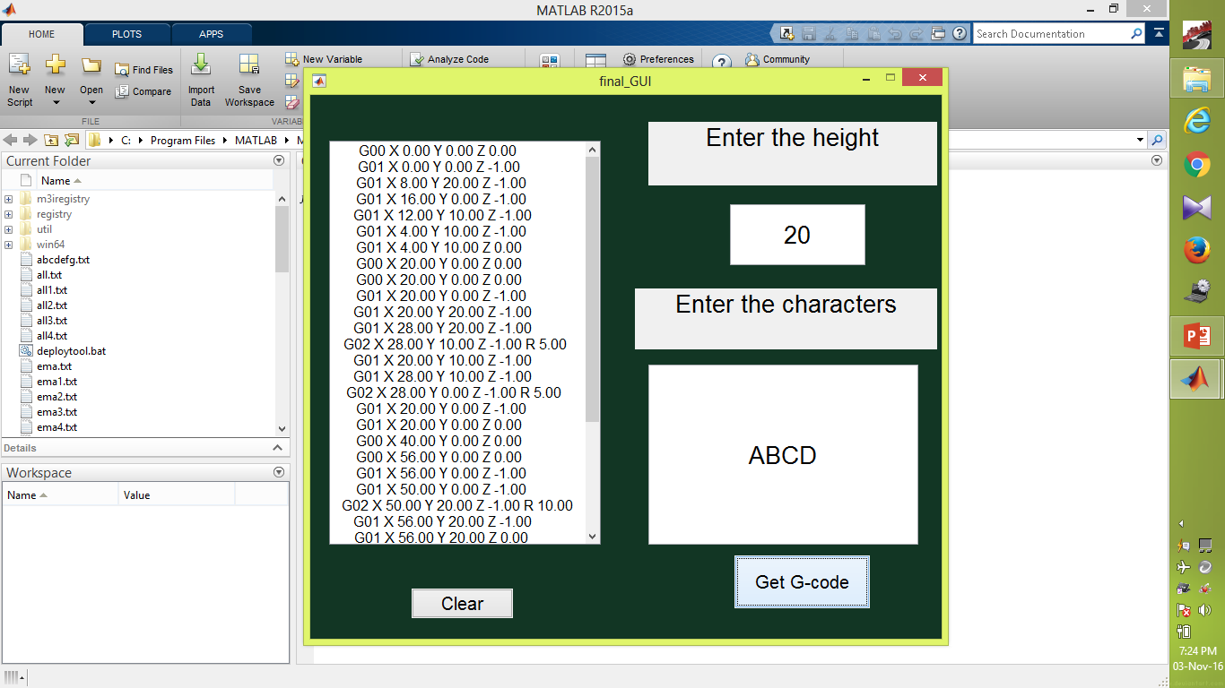
User Friendly Interface

Slide 10
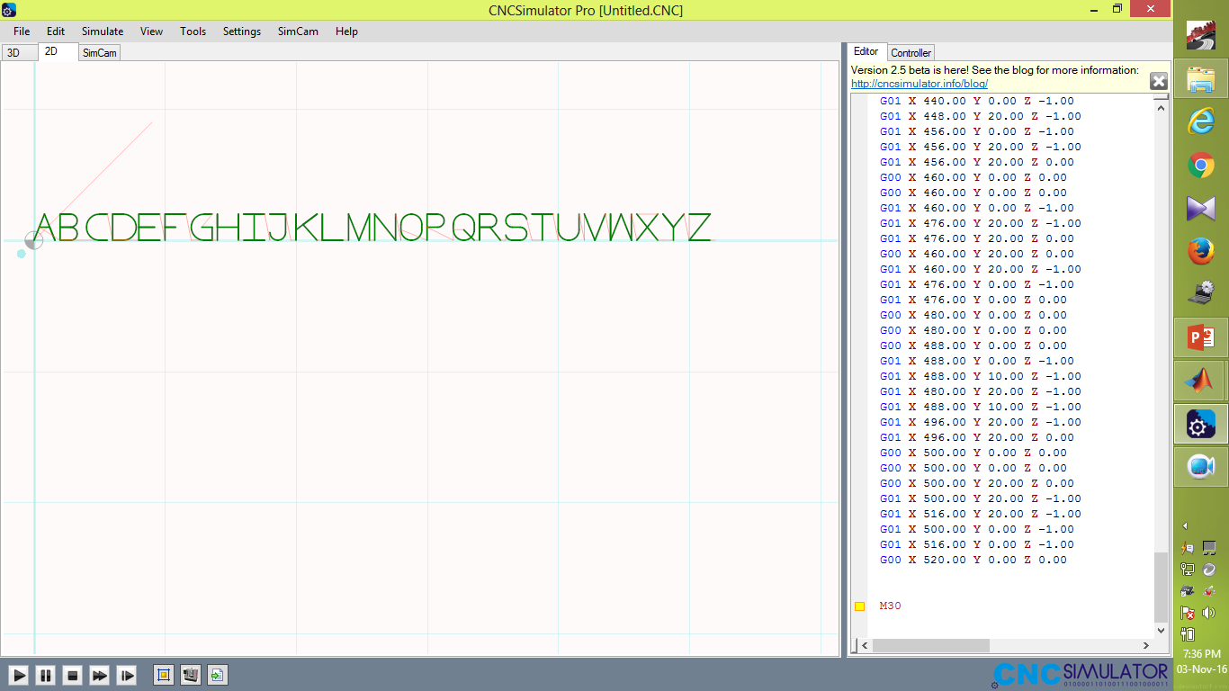

Slide 11
